Slide 1
SEP760 Cyber Physical Systems
Summer 2025
Deep / Machine Learning
W. Booth School of Engineering, McMaster University
Dr. Anwar Mirza
mirzaa24@mcmaster.ca

Slide 2
2. Feedforward Neural Networks (FNN) and Backpropagation
2.1 Multilayer Feedforward Networks
2.2 Backpropagation algorithm
2.3 Working with backpropagation
2.4 Advanced algorithms
2.5 Performance of multilayer perceptrons

Slide 3



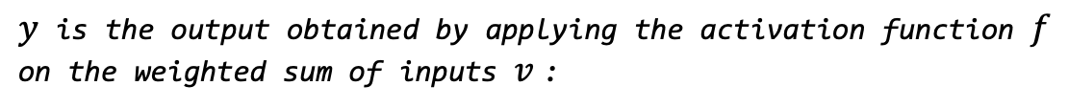
















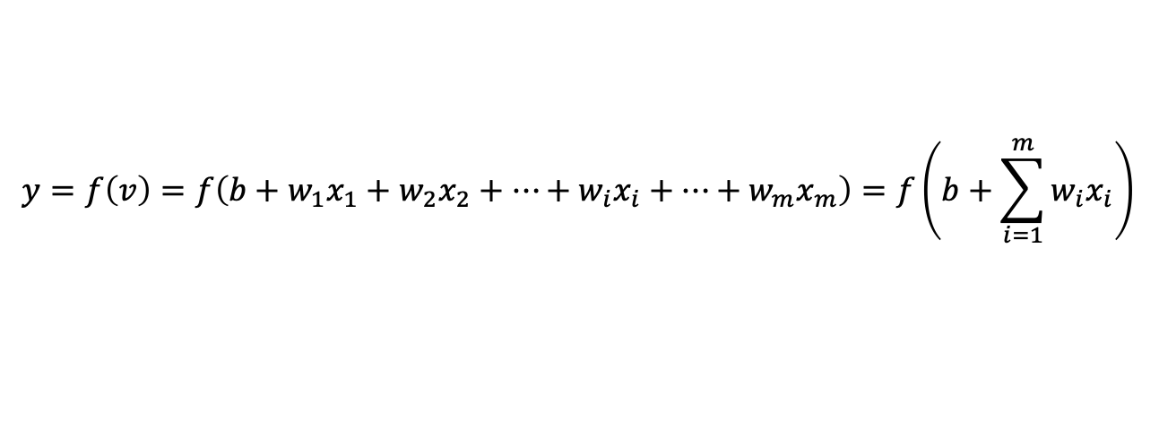




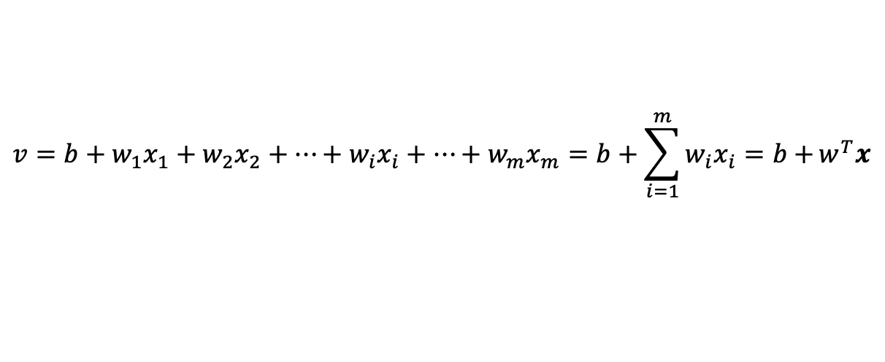












Feedforward Neural Networks
One Output Unit
$$1$$
$$Summation$$
$$Activation$$
$$Function$$
$$x_{1}$$
$$w_{1}$$
$$b$$
$$x_{1}$$
$$x_{2}$$
$$x_{2}$$
$$w_{1}$$
$$w_{2}$$
$$⋮$$
$$w_{2}$$
$$Σ$$
$$v$$
$$f$$
$$y$$
$$⋮$$
$$Y$$
$$x_{i}$$
$$w_{i}$$
$$x_{i}$$
$$w_{i}$$
$$⋮$$
$$w_{m}$$
$$x_{m}$$
$$b$$
$$⋮$$
$$w_{m}$$
$$1$$
$$x_{m}$$
$$Inputs$$
$$Bias$$
$$Output$$
$$x^{T}=\left(x_{1},x_{2},x_{3},⋯,x_{i},⋯{,x}_{m}\right), w^{T}=\left(w_{1},w_{2},w_{3},⋯,w_{i},⋯{,w}_{m}\right)$$
$v$is the weighted sum of inputs:
$$v=b+w_{1}x_{1}+w_{2}x_{2}+⋯+w_{i}x_{i}+⋯+w_{m}x_{m}=b+\sum_{i=1}^{m}{w_{i}x_{i}=b+}w^{T}x$$
$y$is the output obtained by applying the activation function $f$ on the weighted sum of inputs $v$:
$$y=f\left(v\right)=f\left(b+w_{1}x_{1}+w_{2}x_{2}+⋯+w_{i}x_{i}+⋯+w_{m}x_{m}\right)=f\left(b+\sum_{i=1}^{m}{w_{i}x_{i}}\right)$$

Slide 4




































Feedforward Neural Networks
One Output Unit
Perceptron
vs.
Adaline
$$x_{1}$$
$$x_{1}$$
$$x_{2}$$
$$w_{1}$$
$$x_{2}$$
$$w_{1}$$
$$⋮$$
$$w_{2}$$
$$Σ$$
$$v$$
$$y$$
$$⋮$$
$$w_{2}$$
$$Σ$$
$$v$$
$$y$$
$$x_{i}$$
$$w_{i}$$
$$x_{i}$$
$$w_{i}$$
$$⋮$$
$$w_{m}$$
$$⋮$$
$$w_{m}$$
$$x_{m}$$
$$b$$
$$x_{m}$$
$$b$$
$$1$$
$$1$$
$$Inputs$$
$$Bias$$
$$y=f\left(v\right)=threshold\left(v\right)$$
$$Inputs$$
$$Bias$$
$$y=f\left(v\right)=linear(v)=v$$
Error for nth pattern: $e\left(n\right)=d\left(n\right)−y(n)$
Learning Rules
Perceptron Learning Rule
Adaline / Delta Rule / LMS Learning
$$w_{i}\left(n+1\right)=w_{i}\left(n\right)+η d\left(n\right){ x}_{i}\left(n\right)$$
$$b\left(n+1\right)=b\left(n\right)+η d\left(n\right)$$
$$w_{i}\left(n+1\right)=w_{i}\left(n\right)+η e\left(n\right){ x}_{i}\left(n\right)$$
$$b\left(n+1\right)=b\left(n\right)+η e\left(n\right)$$

Slide 5
Single-Layer Feedforward
Neural Network

Slide 6
Limitations of a Single-Layer Feedforward Network (SLFN)
Cannot Solve Non-Linearly Separable Problems
A single-layer perceptron can only learn linearly separable functions (i.e., problems where data can be divided by a straight line/hyperplane).
It fails on classic non-linear problems like the XOR problem, which requires at least one hidden layer (making it a multi-layer perceptron, MLP).
Limited to Linear Decision Boundaries
Since it lacks hidden layers, it can only model linear relationships between inputs and outputs.
Real-world data often requires non-linear decision boundaries, which SLFNs cannot represent.
No Feature Hierarchy or Abstraction
Deep networks learn hierarchical features (e.g., edges → shapes → objects in images), but SLFNs cannot extract higher-level features since they lack hidden layers.
Limited Expressivity (Representational Power)
The Universal Approximation Theorem states that a single hidden layer is sufficient to approximate any continuous function, but a zero-hidden-layer network (SLFN) cannot.
Sensitive to Input Scaling & Preprocessing
Since SLFNs rely on linear transformations, they perform poorly if features are not normalized or are highly correlated.
No Ability to Handle Sequential or Temporal Data
Unlike recurrent neural network RNNs or long shot-term memory LSTMs, SLFNs have no memory and cannot process sequences or time-dependent data.
Vulnerable to Overfitting if Input Dimensionality is High
If the input features are numerous, a single-layer network may overfit due to limited learning capacity.

Slide 7
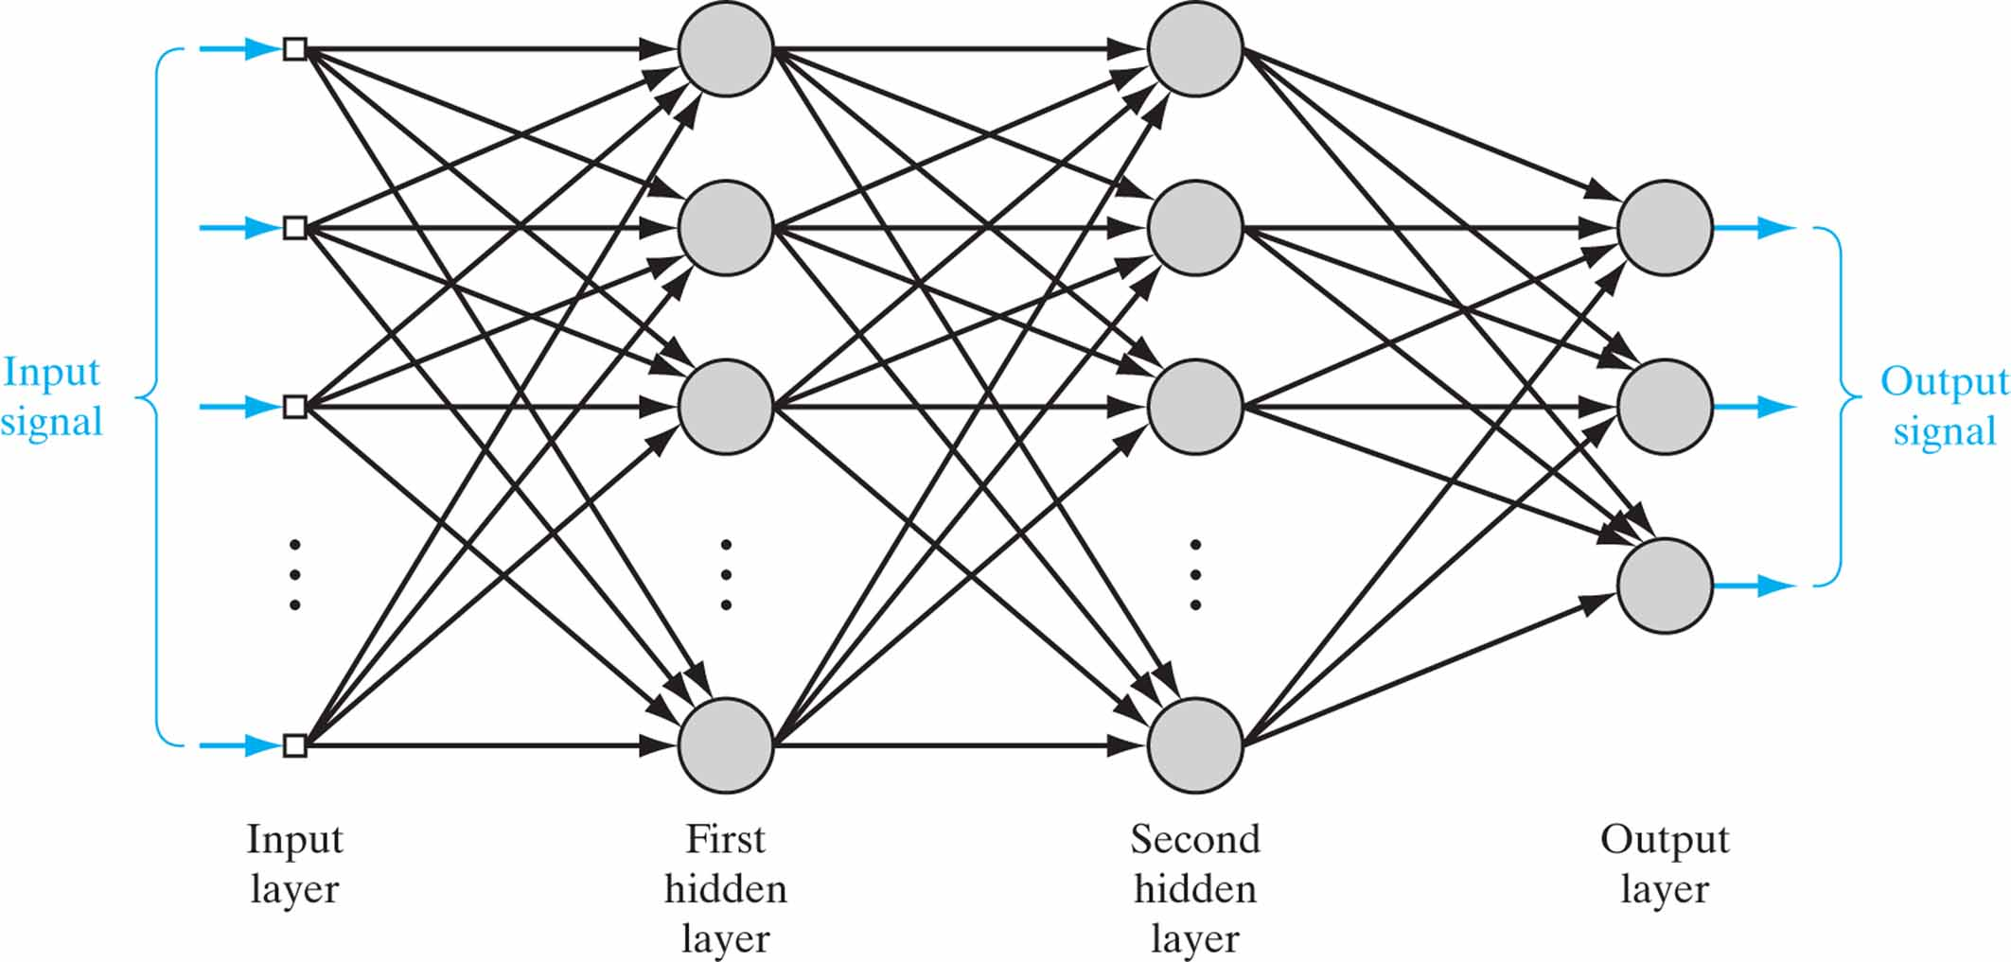
Architectural graph of a multilayer perceptron with two hidden layers.

Slide 8
Motivation
Single-layer networks have severe restrictions
Only linearly separable tasks can be solved
Minsky and Papert (1969)
Showed the power of a two-layer feed-forward network
But didn’t find the solution on how to train the network
Werbos (1974)
Parker (1985), Cun (1985), Rumelhart (1986), Hinton (1987)
Solved the problem of training multi-layer networks by back-propagating the output errors through hidden layers of the network
Backpropagation learning rule

Slide 9
2.1 Multilayer feedforward networks
Important class of neural networks
Input layer (only distributing inputs, without processing)
One or more hidden layers
Output layer
Commonly referred to as multilayer perceptron

Slide 10
Properties of multilayer perceptrons
Neurons include nonlinear activation function
Without nonlinearity, the capacity of the network is reduced to that of a single layer perceptron
Nonlinearity must be smooth (differentiable everywhere), not hard-limiting as in the original perceptron
Often, a logistic function is used:
One or more layers of hidden neurons
Enable learning of complex tasks by extracting features from the input patterns
Full connectivity
Neurons in successive layers are fully interconnected

Slide 11
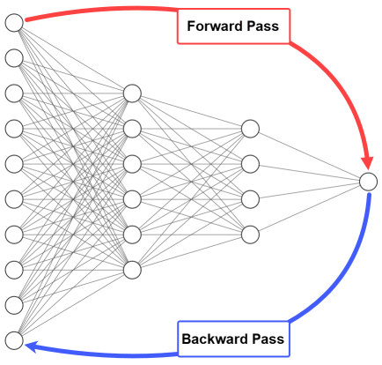
About backpropagation
Multilayer perceptrons can be trained by the backpropagation learning rule
Based on the error-correction learning rule
Generalization of LMS learning rule (used to train ADALINE)
Backpropagation consists of two passes through the network
Forward pass
Input is applied to the network
Input is propagated to the output
Synaptic weights stay frozen
Error signal is calculated
Backward pass
Error signal is propagated backward
Error gradients are calculated
Synaptic weights are adjusted
Notes:
Image source: https://neptune.ai/blog/backpropagation-algorithm-in-neural-networks-guide

Slide 12
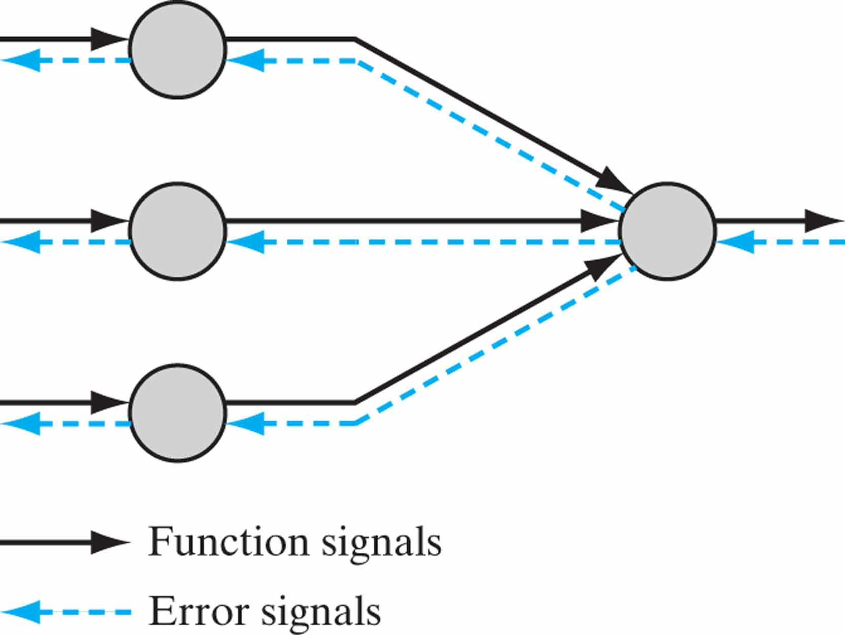
Illustration of the directions of two basic signal flows in a multilayer perceptron: forward propagation of function signals and back propagation of error signals.

Slide 13
2.2 Backpropagation algorithm (1/9)
A set of learning samples (inputs and target outputs)
Error signal at output layer, neuron j, learning iteration n
Instantaneous error energy of output layer with R neurons
Average error energy over all learning set
Notes:
Haykin p.161

Slide 14
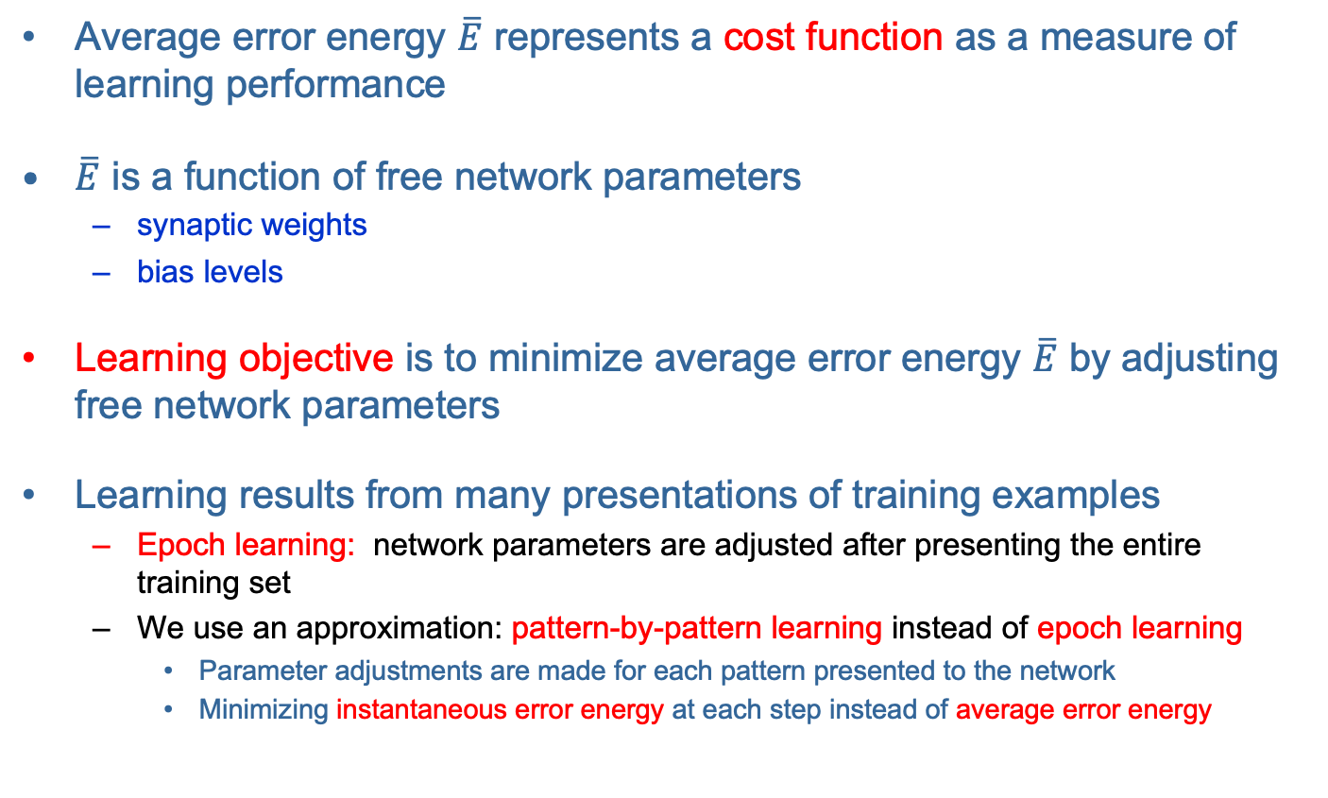
Backpropagation algorithm (2/9)
Average error energy $\overline{E}$ represents a cost function as a measure of learning performance
$\overline{E}$ is a function of free network parameters
synaptic weights
bias levels
Learning objective is to minimize average error energy $\overline{E}$ by adjusting free network parameters
Learning results from many presentations of training examples
Epoch learning: network parameters are adjusted after presenting the entire training set
We use an approximation: pattern-by-pattern learning instead of epoch learning
Parameter adjustments are made for each pattern presented to the network
Minimizing instantaneous error energy at each step instead of average error energy

Slide 15
Backpropagation algorithm (3/9)
Similar to the LMS algorithm, backpropagation applies correction of weights proportional to the partial derivative
Expressing this gradient by the chain rule
Instantaneous error energy
output error
network output
induced local field
synaptic weight

Slide 16
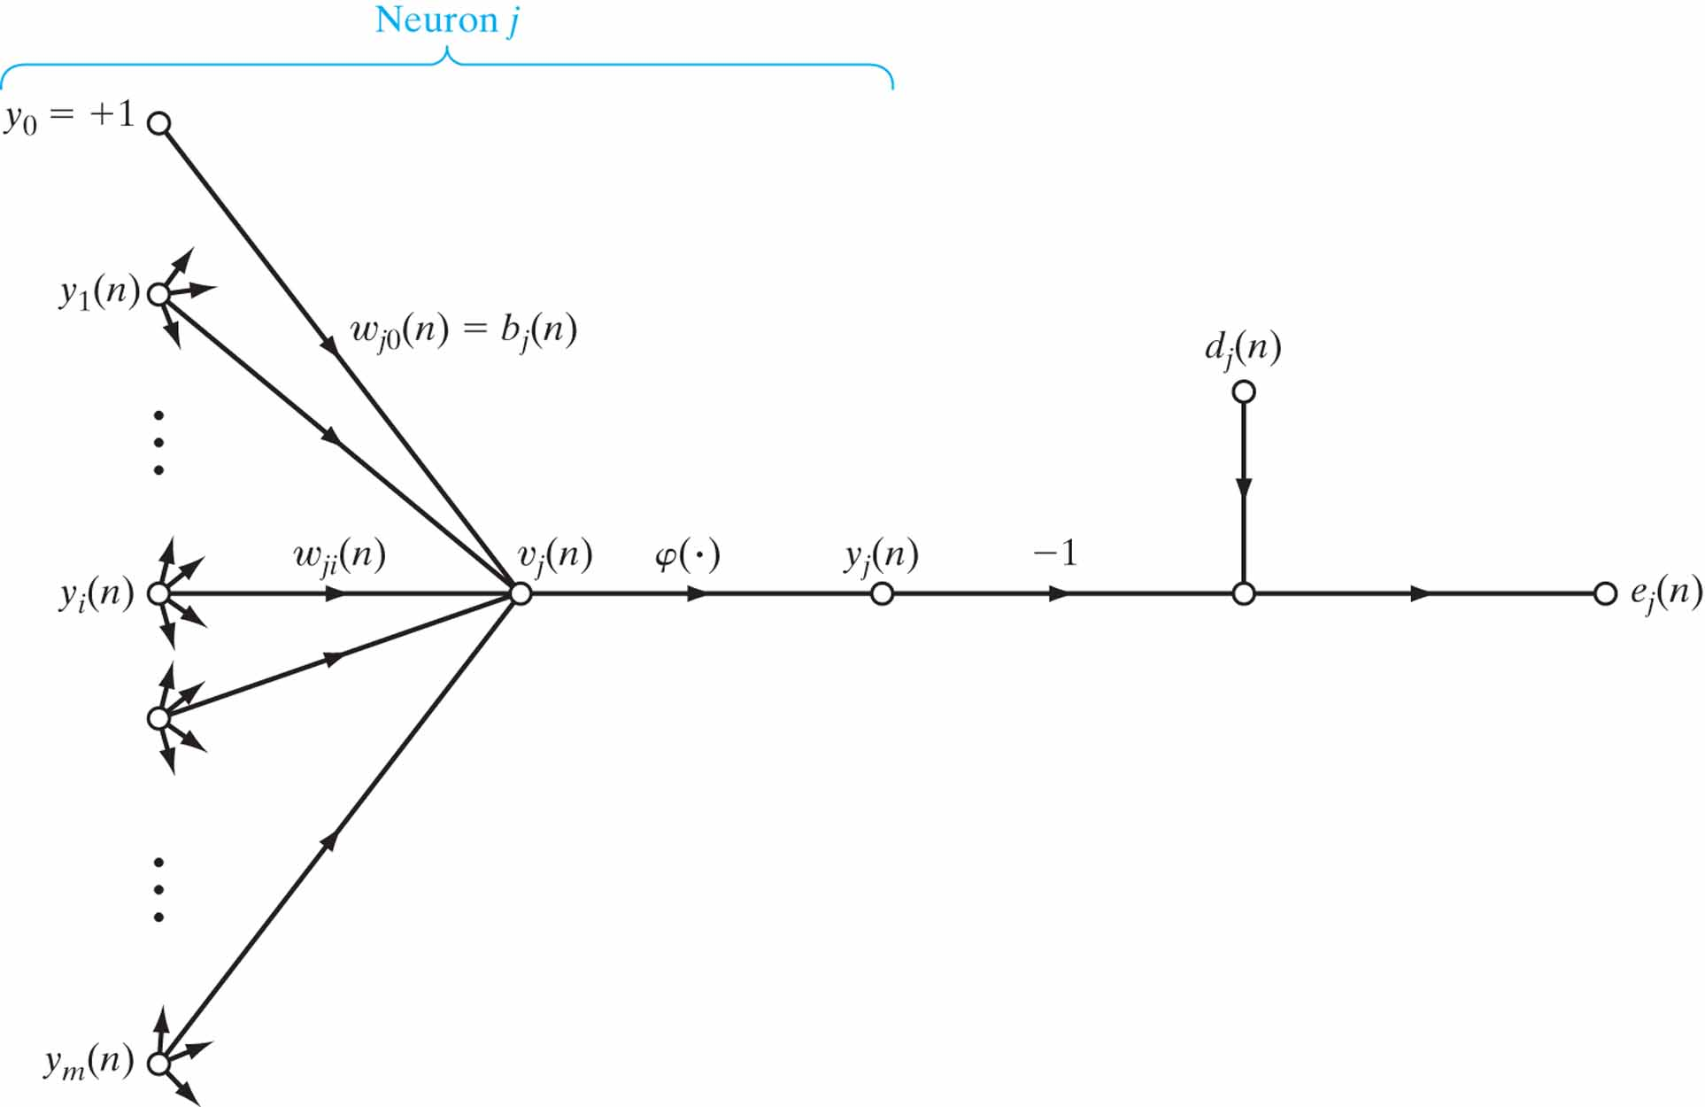
Signal-flow graph highlighting the details of output neuron j.

Slide 17
Backpropagation algorithm (4/9)
Gradient on output error
Gradient on network output
Gradient on induced local field
Gradient on synaptic weight

Slide 18
Backpropagation algorithm (5/9)
Putting gradients together
Correction of synaptic weight is defined by the delta rule
Learning rate
Local gradient
Notes:
Learning rate: eta (η)

Slide 19
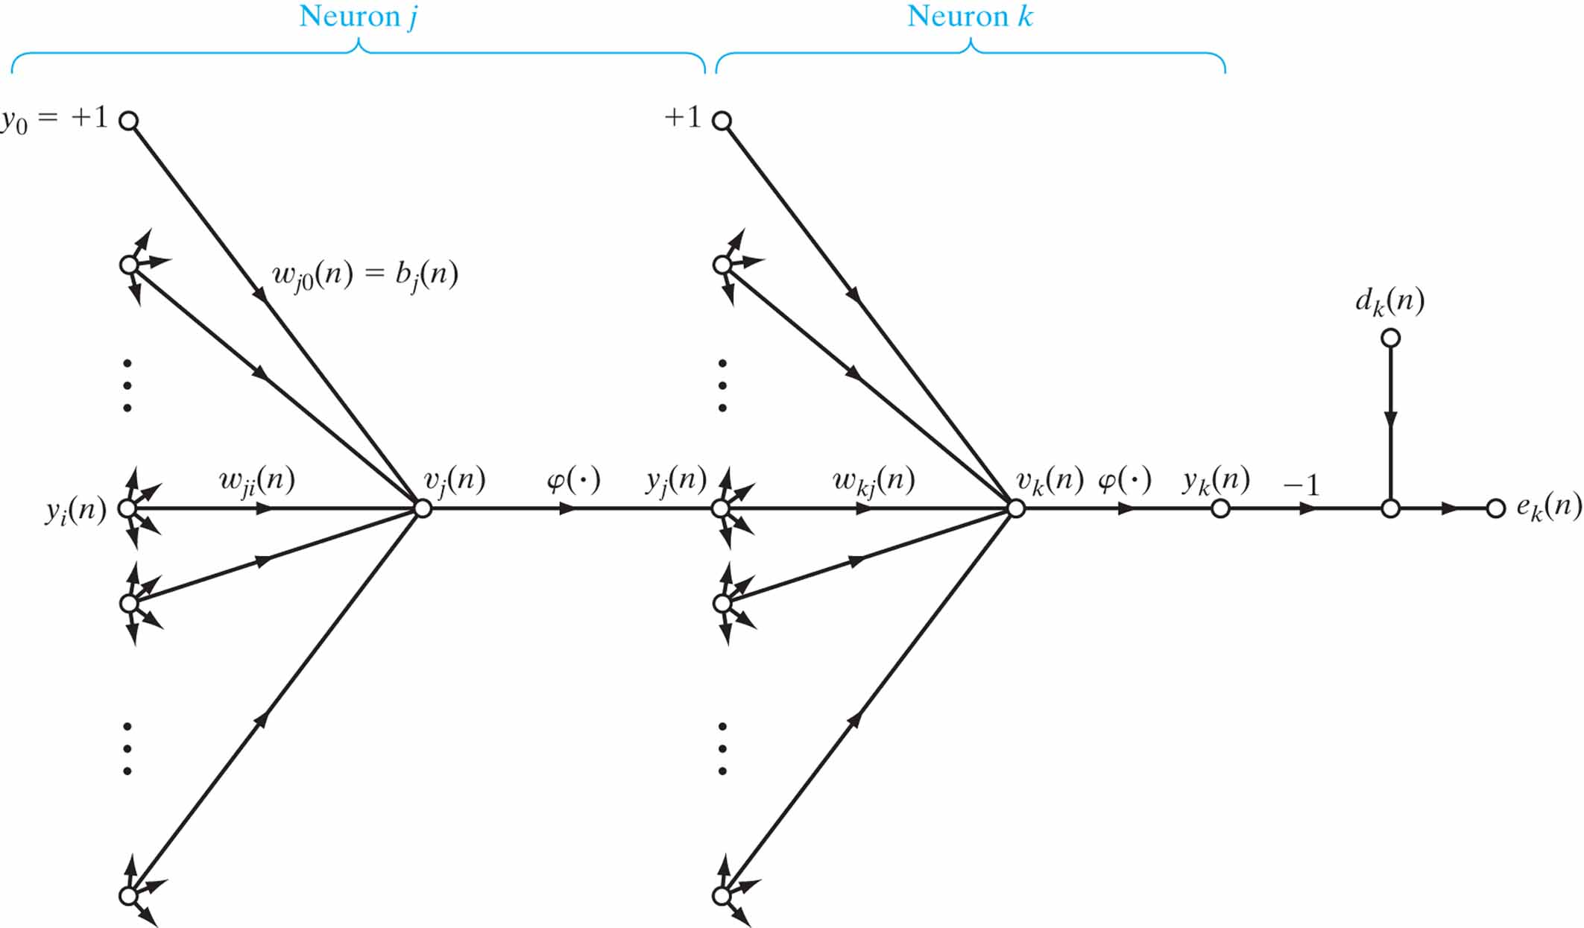
Signal-flow graph highlighting the details of output neuron k connected to hidden neuron j.

Slide 20
Backpropagation algorithm (6/9)
CASE 1 Neuron j is an output node
Output error e_{j}(n) is available
Computation of local gradient is straightforward
CASE 2 Neuron j is a hidden node
Hidden error is not available → Credit assignment problem
Local gradient solved by backpropagating errors through the network
How to calculate the derivative of output error energy E on hidden layer output y_{j} ?
Notes:
The green text is the invitation to the next slide.

Slide 21
Backpropagation algorithm (7/9)
CASE 2 Neuron j is a hidden node ...
Instantaneous error energy of the output layer with R neurons
Expressing the gradient of output error energy E on hidden layer output y_{j}

Slide 22
Backpropagation algorithm (8/9)
CASE 2 Neuron j is a hidden node ...
Finally, combining ansatz for hidden layer local gradient
and gradient of output error energy on hidden layer output
gives final result for hidden layer local gradient

Slide 23
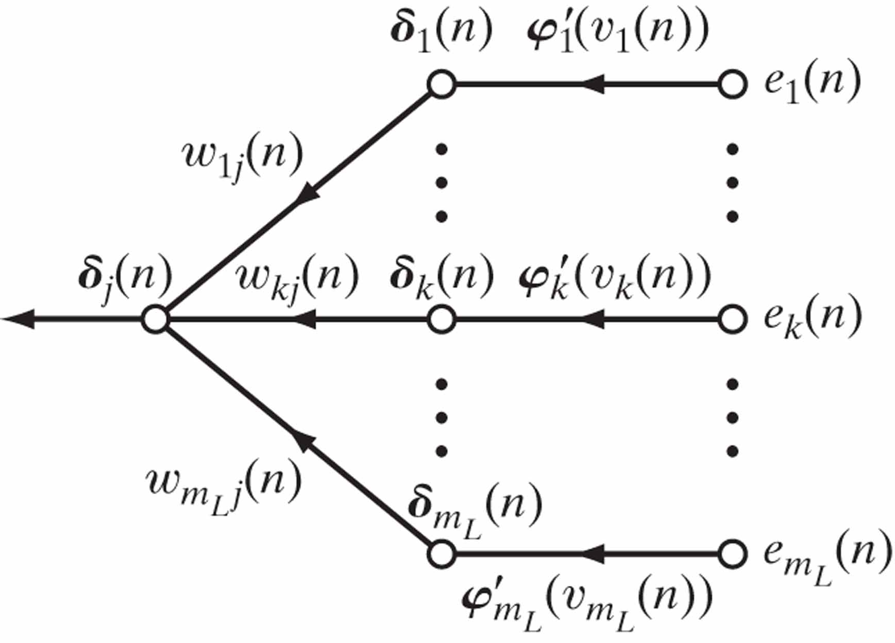
Signal-flow graph of a part of the adjoint system pertaining to back-propagation of error signals.

Slide 24
Backpropagation algorithm (9/9)
Backpropagation summary
Local gradient of an output node
Local gradient of a hidden node
Weight Learning Local Input of correction rate gradient neuron j

Slide 25
Two passes of computation
Forward pass
Input is applied to the network and propagated to the output
Inputs → Hidden layer output → Output layer output → Output error
→ → →
Backward pass
Recursive computing of local gradients
Output local gradients → Hidden layer local gradients
→
Synaptic weights are adjusted according to local gradients

Slide 26
Summary of the backpropagation algorithm
Initialization
Pick weights and biases from the uniform distribution with zero mean and variance that induces local fields between the linear and saturated parts of the logistic function
Presentation of training samples
For each sample from the epoch, perform forward pass and backward pass
Forward pass
Propagate training sample from network input to the output
Calculate the error signal
Backward pass
Recursive computation of local gradients from output layer toward input layer
Adaptation of synaptic weights according to generalized delta rule
Iteration
Iterate steps 2-4 until the stopping criterion is met
Notes:
Run the MATLAB demo on the next slide for a practical demonstration of backpropagation calculation.

Slide 27
Backpropagation for ADALINE
Using backpropagation learning for ADALINE
No hidden layers, one output neuron
Linear activation function
Backpropagation rule
Original delta rule
Backpropagation is a generalization of a delta rule

Slide 28
2.3 Working with backpropagation
Efficient application of backpropagation requires some “fine-tuning”
Various parameters, functions, and methods should be selected
Training mode (sequential / batch)
Activation function
Learning rate
Momentum
Stopping criterium
Heuristics for efficient backpropagation
Methods for improving generalization

Slide 29


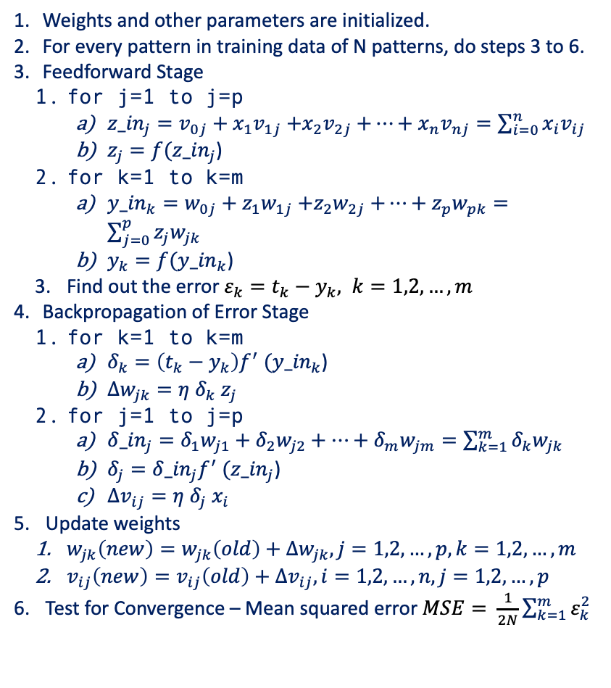














Two-Layer Feedforward Neural Network – Backpropagation Algorithm
Algorithm
Weights and other parameters are initialized.
For every pattern in training data of N patterns, do steps 3 to 6.
Feedforward Stage
for j=1 to j=p
${z_in}_{j}=v_{0j}+x_{1}v_{1j}$ $+x_{2}v_{2j}$ $+⋯+x_{n}v_{nj}=\sum_{i=0}^{n}{x_{i}v_{ij}}$
$z_{j}=f({z_in}_{j}$)
for k=1 to k=m
${y_in}_{k}=w_{0j}+z_{1}w_{1j}$ $+z_{2}w_{2j}$ $+⋯+z_{p}w_{pk}=\sum_{j=0}^{p}{z_{j}w_{jk}}$
$y_{k}=f({y_in}_{k}$)
Find out the error $ε_{k}=t_{k}−y_{k}, k=1,2,…,m$
Backpropagation of Error Stage
for k=1 to k=m
$δ_{k}=\left(t_{k}−y_{k}\right)f^{′} ({y_in}_{k}\text{)}$
${Δw}_{jk}=η δ_{k} z_{j}$
for j=1 to j=p
${δ_in}_{j}=δ_{1}w_{j1}+δ_{2}w_{j2}+⋯+δ_{m}w_{jm}=\sum_{k=1}^{m}{δ_{k}w_{jk}}$
$δ_{j}={δ_in}_{j}f^{′} ({z_in}_{j}\text{)}$
${Δv}_{ij}=η δ_{j} x_{i}$
Update weights
$w_{jk}\left(new\right)=w_{jk}\left(old\right)+{Δw}_{jk}, j=1,2,…,p, k=1,2,…,m$
$v_{ij}\left(new\right)=v_{ij}\left(old\right)+{Δv}_{ij}, i=1,2,…,n, j=1,2,…,p$
Test for Convergence – Mean squared error $MSE= \frac{1}{2N}\sum_{k=1}^{m}{ε_{k}^{2}}$
Architecture
1
$$v_{01}$$
1
$$w_{01}$$
$$v_{02}$$
$$w_{02}$$
X₁
$$v_{11}$$
Z₁
$$w_{11}$$
Y₁
$$v_{12}$$
$$w_{12}$$
X₂
Z₂
Y₂
$$v_{2p}$$
$$w_{2m}$$
X_{i}
$$v_{ij}$$
Z_{j}
Y_{k}
$$v_{ip}$$
$$w_{jm}$$
$$w_{jk}$$
X_{n}
$$v_{np}$$
Z_{p}
$$w_{pm}$$
Y_{m}

Slide 30
Sequential vs. batch training
Learning results from many presentations of training examples
Epoch = presentation of the entire training set
Batch training (Epoch-by-Epoch Training)
Weight updating after the presentation of a complete epoch
Training is more accurate but very slow
Sequential training (Pattern-by-Pattern or Stochastic Training)
Weight updating after the presentation of each training example
Stochastic nature of learning, faster convergence
Important practical reasons for sequential learning:
The algorithm is easy to implement
Provides an effective solution to large and difficult problems
Therefore sequential training is the preferred training mode
A good practice is random order of presentation of training examples

Slide 31
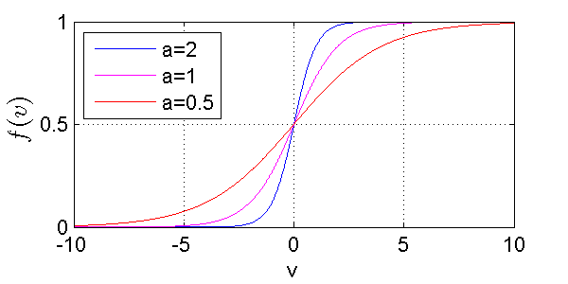
Activation function
Derivative of activation function is required for computation of local gradients
The only requirement for activation function: differentiability
Commonly used: logistic function
Derivative of the logistic function
Local gradient can be calculated without explicit knowledge of the activation function

Slide 32
Other activation functions
Using sin() activation functions
Equivalent to traditional Fourier analysis
Network with sin() activation functions can be trained by backpropagation
Example: Approximating a periodic function by
8 sigmoid hidden neurons 4 sin hidden neurons

Slide 33
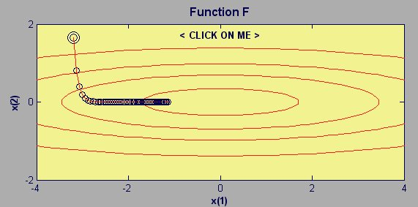

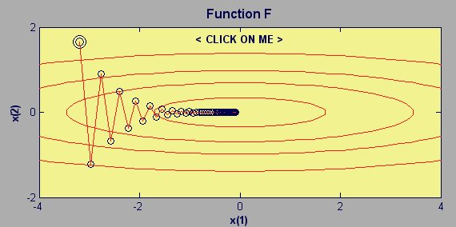

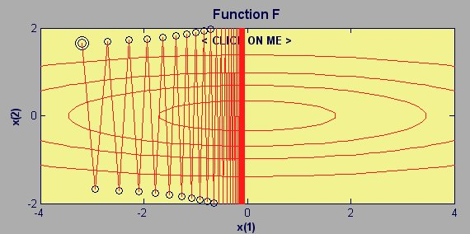

Learning rate
Learning procedure requires
Change in the weight space to be proportional to error gradient
True gradient descent requires infinitesimal steps
Learning in practice
Factor of proportionality is learning rate η →
Choose a learning rate as large as possible without leading to oscillations
Notes:
nnd9sdq

Slide 34
Stopping criteria
Generally, backpropagation cannot be shown to converge
No well-defined criteria for stopping its operation
Possible stopping criteria
Gradient vector
Euclidean norm of the gradient vector reaches a sufficiently small gradient
Output error
Output error is small enough
Rate of change in the average squared error per epoch is sufficiently small
Generalization performance
Generalization performance has peaked or is adequate
Max number of iterations
We are out of time ...

Slide 35
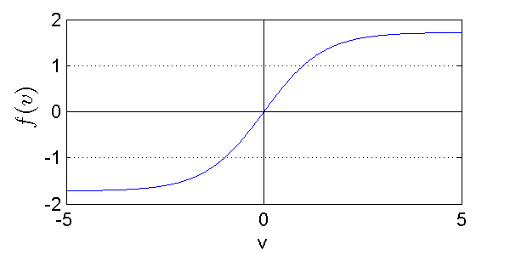
Heuristics for efficient backpropagation (1/3)
Maximizing information content
General rule: every training example presented to the backpropagation algorithm should be chosen on the basis that its information content is the largest possible for the task at hand
Simple technique: randomize the order in which examples are presented from one epoch to the next
Activation function
Faster learning with antisimetric sigmoid activation functions
Popular choice is:

Slide 36
Heuristics for efficient backpropagation (2/3)
Target values
Must be in the range of the activation function
Offset is recommended, otherwise learning is driven into saturation
Example: max(target) = 0.9 max(f)
Preprocessing inputs
Normalizing mean to zero
Decorrelating input variables (by using principal component analysis)
Scaling input variables (variances should be approx. equal)
Original a) Zero mean b) Decorrelated c) Equalized variance

Slide 37
Heuristics for efficient backpropagation (3/3)
Initialization
Choice of initial weights is important for a successful network design
Large initial values → saturation
Small initial values → slow learning due to operation only in the saddle point near origin
Good choice lies between these extreme values
Standard deviation of induced local fields should lie between the linear and saturated parts of its sigmoid function
tanh activation function example (a=1.72, b=0.67): synaptic weights should be chosen from a uniform distribution with zero mean and standard deviation
Learning from hints
Prior information about the unknown mapping can be included in the learning process
Initialization
Possible invariance properties, symmetries, ...
Choice of activation functions
m ... number of synaptic weights

